Slide 1
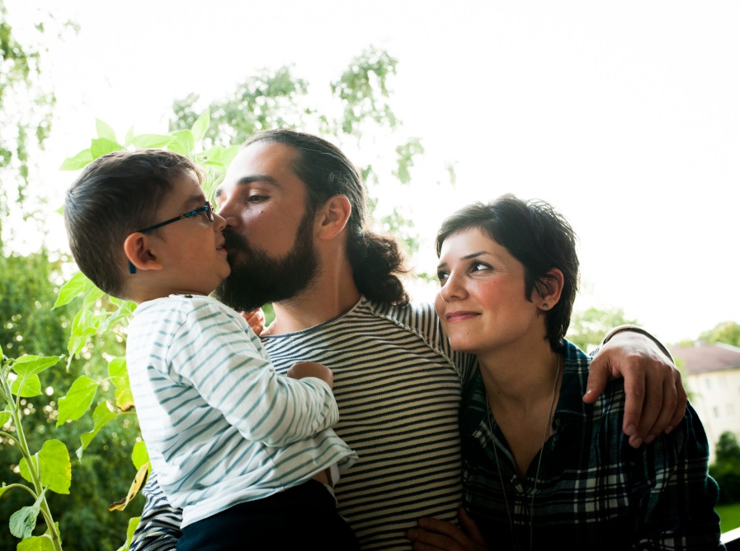
Notes:
Photo: “Refugees should have the right to family unity. Pictured here is a Syrian family who escaped their country and are safe in Norway: two-year-old Kahraman with his father Hennan Karajoul and mother Sherihan Isso. Unfortunately, members of many other refugee families are separated from one another.” CREDIT: © Helge Lien | Amnesty International

Slide 2
Who is a refugee?
Training Materials on Refugee Rights
March 23, 2016

Slide 3
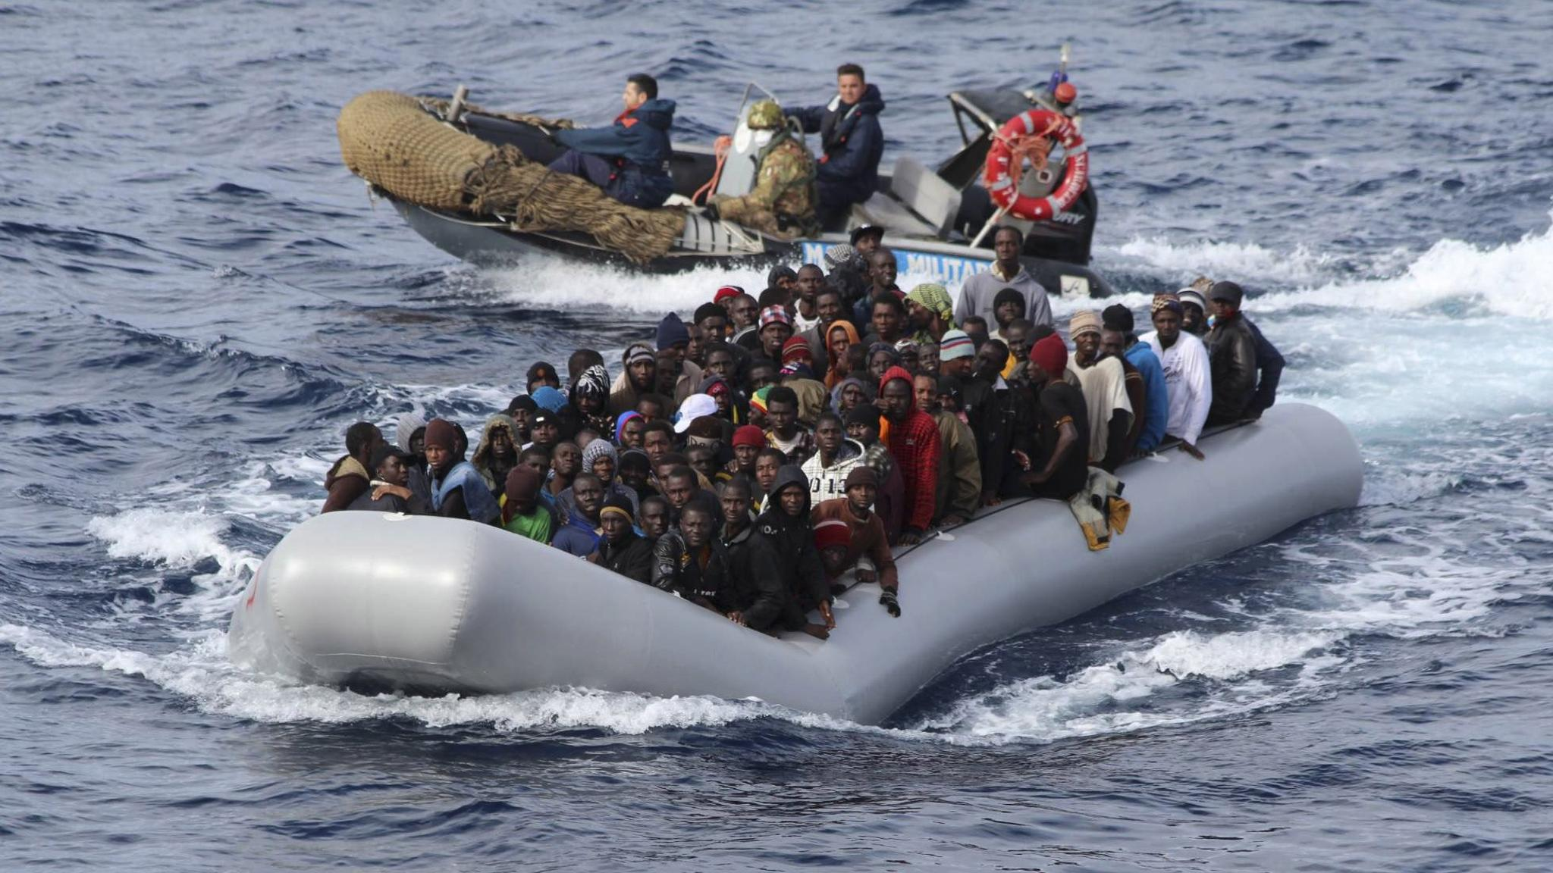
Everyone has the right to seek and to enjoy in other countries asylum from persecution.
~ Universal Declaration of Human Rights, art. 14(1)
Notes:
Photo: http://www.dochas.ie/blog/ngo-reactions-mediterranean-boat-crisis
International Human Rights Principles and Legal Standards
Universal Declaration of Human Rights
Everyone has the right to seek and to enjoy in other countries asylum from persecution. (art. 14(1))
Everyone has the right to leave any country, including his own, and to return to his country. (art. 13(2))
No one shall be subjected to torture or to cruel, inhuman or degrading treatment or punishment. (art. 5)
1951 Convention Relating to the Status of Refugees
Definition of a refugee (art. 1)
Non-refoulement – obligation not to return a refugee to a place where their life or freedom would be at risk (art. 33)
Article 33 Prohibition of expulsion or return ("refoulement")
(1) No Contracting State shall expel or return ("refouler") a refugee in any manner whatsoever to the frontiers of territories where his life or freedom would be threatened on account of his race, religion, nationality, membership of a particular social group or political opinion.
(2) The benefit of the present provision may not, however, be claimed by a refugee whom there are reasonable grounds for regarding as a danger to the security of the country in which he is, or who, having been convicted by a final judgment of a particularly serious crime, constitutes a danger to the community of that country.
1984 Convention against Torture
Non-refoulement – obligation not to return anyone to a risk of torture (art. 3)

Slide 4
Who is a refugee?
Outside their country
Due to a well-founded fear
Of persecution
On one of 5 grounds
Unable to go back
Notes:
Photo: ©UNHCR/I.Prickett http://unhcr.org/g-558180b96 “Syrian Kurdish refugees cross into Turkey from Syria, near the town of Kobani. The war that erupted in Syria in 2011 has propelled it into becoming the world’s largest driver of displacement.”
The rights of refugees are protected in International law under the 1951 Convention relating to the Status of Refugees. Countries like Canada that are parties to the convention are obligated to protect the rights of refugees who arrive in their country.
1951 Convention Relating to the Status of Refugees
Article 1 Definition of the term "Refugee"
A. For the purposes of the present Convention, the term "refugee" shall apply to any person who: …
(2) As a result of events occurring before 1 January 1951 and owing to well-founded fear of being persecuted for reasons of race, religion, nationality, membership of a particular social group or political opinion, is outside the country of his nationality and is unable or, owing to such fear, is unwilling to avail himself of the protection of that country; or who, not having a nationality and being outside the country of his former habitual residence as a result of such events, is unable or, owing to such fear, is unwilling to return to it.

Slide 5
Outside their Country
Notes:
Photo: ©UNHCR/I.Prickett http://unhcr.org/g-558180b96 “Syrian Kurdish refugees cross into Turkey from Syria, near the town of Kobani. The war that erupted in Syria in 2011 has propelled it into becoming the world’s largest driver of displacement.”
We are facing a global crisis of forced migration. In June 2015, the UN Refugee Agency reported that there were 58,000,000 persons of concern under its mandate, including refugees, refugee claimants (aka asylum seekers, spontaneous arrivals), internally displaced and stateless persons. That means more than 1 ½ times the entire population of Canada lacks the protection of their country.
Refugee: rights are protected by 1951 Convention Relating to the Status of Refugees
Claimant: until there is a formal process which determines they are NOT a refugee; they are considered a refugee and are protected by the 1951 Refugee Convention
Internally displaced: may also be at risk of persecution but the Refugee Convention does not apply, since they are not outside the country of origin
Stateless: no country recognizes the person as its citizen
Migrant: some migrants are forced to move for life and death reasons (extreme poverty; environmental degradation drought), but they are not considered refugees unless they also face persecution.
Sources:
UNHCR, Mid-Year Trends, June 2015 http://www.unhcr.org/56701b969.html
Statistics Canada, Canada’s population estimates, first quarter 2015 http://www.statcan.gc.ca/daily-quotidien/150617/dq150617c-eng.htm
88. It is a general requirement for refugee status that an applicant who has a nationality be outside the country of his nationality. There are no exceptions to this rule. International protection cannot come into play as long as a person is within the territorial jurisdiction of his home country.
Source: UNHCR Handbook and Guidelines on Procedures and Criteria for Determining Refugee Status http://www.unhcr.org/3d58e13b4.html

Slide 6
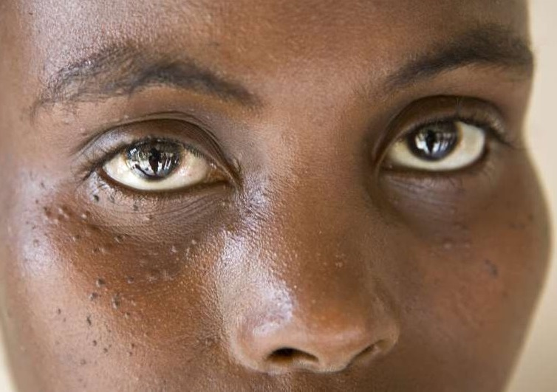
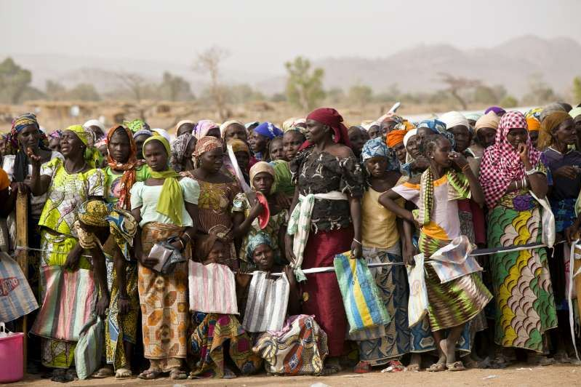
Well-founded Fear
Personal fear
This is called the subjective element
Good reason to be fearful
This is called the objective element
Notes:
Photo (L): Zeinab*, 22, from Borno State in Nigeria, fled when insurgents attacked her home area in January 2014. Both her parents were shot when they attempted to escape, but she and her siblings managed to scramble in different directions. They are still separated. *Name changed for protection reasons © UNHCR/H.Caux http://unhcr.org/g-558180b96
Photo (R): Refugee women queue to receive high protein biscuits in Minawao. The World Food Programme is also distributing regular food rations, including rice, oil, salt and a blend of corn and soya bean. As of March 2015, Minawao camp [Cameroon] was hosting some 33,000 Nigerian refugees, mainly originating from Borno state. The refugees are of Kanuri, Haussa, Fulbe, Arab and Peuhl origin. © UNHCR/H.Caux http://unhcr.org/g-5513d75e9

Slide 7
Persecution
There is no universally accepted definition of
“persecution”
Notes:
Photo: Baw Meh, age 75, fled Kayah state in Myanmar in 1996. In her 18 years in Ban Mai Nai Soi camp, she has seen her husband die and family members resettle to third countries.* © UNHCR/R.Arnold http://unhcr.org/g-53a467656
While there is no universally accepted definition of “Persecution”, it can be conceived as a range of harmful treatment along a continuum, which starts with prejudice and discrimination, and reaches extremes such as genocide. Discrimination in different forms combined with other adverse factors (e.g. general atmosphere of insecurity in the country of origin) can combine to result in persecution on “cumulative grounds”.
(b) Persecution
51. There is no universally accepted definition of “persecution”, and various attempts
to formulate such a definition have met with little success. From Article 33 of the 1951
Convention, it may be inferred that a threat to life or freedom on account of race,
religion, nationality, political opinion or membership of a particular social group is always
persecution. Other serious violations of human rights – for the same reasons – would
also constitute persecution.
52. Whether other prejudicial actions or threats would amount to persecution will depend
on the circumstances of each case, including the subjective element to which reference
has been made in the preceding para. graphs. The subjective character of fear of
persecution requires an evaluation of the opinions and feelings of the person concerned.
it is also in the light of such opinions and feelings that any actual or anticipated measures
against him must necessarily be viewed. Due to variations in the psychological make-up
of individuals and in the circumstances of each case, interpretations of what amounts to
persecution are bound to vary.
53. In addition, an applicant may have been subjected to various measures not in
themselves amounting to persecution (e.g. discrimination in different forms), in some
cases combined with other adverse factors (e.g. general atmosphere of insecurity in
the country of origin). In such situations, the various elements involved may, if taken
together, produce an effect on the mind of the applicant that can reasonably justify a
claim to well-founded fear of persecution on “cumulative grounds”.
Needless to say, it is not possible to lay down a general rule as to what cumulative reasons can give rise
to a valid claim to refugee status. This will necessarily depend on all the circumstances,
including the particular geographical, historical and ethnological context.
Source: UNHCR Handbook and Guidelines on Procedures and Criteria for Determining Refugee Status http://www.unhcr.org/3d58e13b4.html
*Angelina Jolie revisits Myanmar refugees on World Refugee Day
UNHCR's Special Envoy Angelina Jolie spent this year's World Refugee Day with Karenni refugees from Myanmar. Some have been in exile in Thailand for 30 years, making this one of the longest-running refugee situations in the world.
On her fourth visit to the refugee camps in Thailand, Jolie met Baw Meh's family, three generations of refugees who have lived in Ban Mai Nai Soi camp since 1996.
The family told Jolie they fled Myanmar's Kayah state thinking they would return home shortly. Eighteen years later, they are still here. Baw Meh, 75, lost her husband last year. He died before he could fulfill his dream of returning home. Some of their family members have been resettled to third countries. Others have chosen to stay. Baw Meh has refused to go, preferring to stay close to her village.
Like many refugees along the border, her family is watching the reform process in Myanmar closely and mulling the prospect of eventual return. "After 30 years in exile, the best solution we can give these refugees is the right and power to choose their own way forward," said Jolie. "This is our chance to get it right, to break the vicious cycle of conflict and displacement once and for all."

Slide 8
5 Convention Grounds
Religion
Nationality
Race
Social group
Political opinion
Notes:
Photo [Race]: Baw Meh, a Karen refugee now aged 75, fled Kayah state in Myanmar in 1996. In her 18 years in Ban Mai Nai Soi camp, she has seen her husband die and family members resettle to third countries.* © UNHCR/R.Arnold http://unhcr.org/g-53a467656
Photo [Religion]: Ismail wrote a book about the history of Islam in Central African Republic, and travelled from the town of Boda to Bangui in December to find a publisher. The conflict erupted a few days later. 'I am trapped,' he says. 'I cannot go to Boda to be with my family, and I cannot flee the country and leave them behind.' © UNHCR/A.Greco http://unhcr.org/g-533593d46
Photo [Nationality]: Cenelia, 41, makes intricate beaded bracelets as part of her family's handicraft business. She lives with her husband and children at Chami Puru, a settlement for displaced indigenous Emebera Chami people in Caqueta, Colombia. © UNHCR/S.Rich http://unhcr.org/g-54f9c2396
Photo [Social Group]: Zeinab*, 22, from Borno State in Nigeria, fled when insurgents attacked her home area in January 2014. Both her parents were shot when they attempted to escape, but she and her siblings managed to scramble in different directions. They are still separated. *Name changed for protection reasons – Women can be considered members of a particular social group if the persecution they fear is due to their gender. © UNHCR/H.Caux http://unhcr.org/g-558180b96
Photo [Political opinion]: A Syrian Love Story - Comrades and lovers Amer and Raghda met in a Syrian prison cell. In 2009, Raghda is back in prison leaving Amer to look after their 4 boys alone; but as the ‘Arab Spring’ sweeps the region, the family’s fate shifts irrevocably. Filmed over 5 years, the film charts their incredible odyssey to political freedom. For Raghda and Amer, it is a journey of hope, dreams and despair: for the revolution, their homeland and each other. Trailer: http://youtu.be/30JqnWtLvlU
5 Convention Grounds refer to the list articulated in the 1951 Convention relating to the Status of Refugees
69. Discrimination on racial grounds will frequently amount to persecution in the sense of the 1951 Convention. This will be the case if, as a result of racial discrimination, a person’s human dignity is affected to such an extent as to be incompatible with the most elementary and inalienable human rights, or where the disregard of racial barriers is subject to serious consequences.
72. Persecution for “reasons of religion” may assume various forms, e.g. prohibition of membership of a religious community, of worship in private or in public, of religious instruction, or serious measures of discrimination imposed on persons because they practise their religion or belong to a particular religious community.
74. The term “nationality” in this context is not to be understood only as “citizenship”. It refers also to membership of an ethnic or linguistic group and may occasionally overlap with the term “race”. Persecution for reasons of nationality may consist of adverse attitudes and measures directed against a national (ethnic, linguistic) minority and in certain circumstances the fact of belonging to such a minority may in itself give rise to well-founded fear of persecution.
77. A “particular social group” normally comprises persons of similar background, habits or social status. A claim to fear of persecution under this heading may frequently overlap with a claim to fear of persecution on other grounds, i.e. race, religion or nationality.
78. Membership of such a particular social group may be at the root of persecution because there is no confidence in the group’s loyalty to the Government or because the political outlook, antecedents or economic activity of its members, or the very existence of the social group as such, is held to be an obstacle to the Government’s policies.
80. Holding political opinions different from those of the Government is not in itself a ground for claiming refugee status, and an applicant must show that he has a fear of persecution for holding such opinions. This presupposes that the applicant holds opinions not tolerated by the authorities, which are critical of their policies or methods. It also presupposes that such opinions have come to the notice of the authorities or are attributed by them to the applicant.
Source: UNHCR Handbook and Guidelines on Procedures and Criteria for Determining Refugee Status http://www.unhcr.org/3d58e13b4.html

Slide 9
Unable to go back
Notes:
Photo: January 31, 2014: Thousands of residents wait to receive food aid distributed by the UN Relief and Works Agency (UNRWA) at the al-Yarmouk camp, south of Damascus, Syria UNRWA http://d.ibtimes.co.uk/en/full/1365503/syria-crowds.jpg?w=736
98. Being unable to avail himself of such protection implies circumstances that are beyond the will of the person concerned. There may, for example, be a state of war, civil war or other grave disturbance, which prevents the country of nationality from extending protection or makes such protection ineffective. Protection by the country of nationality may also have been denied to the applicant. Such denial of protection may confirm or strengthen the applicant’s fear of persecution, and may indeed be an element of persecution.
100. The term unwilling refers to refugees who refuse to accept the protection of the Government of the country of their nationality. It is qualified by the phrase “owing to such fear”.
Source: UNHCR Handbook and Guidelines on Procedures and Criteria for Determining Refugee Status http://www.unhcr.org/3d58e13b4.html

Slide 10
Case Studies
Notes:
Photo: “Refugees should have the right to family unity. Pictured here is a Syrian family who escaped their country and are safe in Norway: two-year-old Kahraman with his father Hennan Karajoul and mother Sherihan Isso. Unfortunately, members of many other refugee families are separated from one another.” CREDIT: © Helge Lien | Amnesty International
EXERCISE:
Read more about this family here, then try to answer the questions below:
https://www.amnesty.org/en/latest/campaigns/2015/10/syria-refugees-new-life-norway-resettlement/
Does the family pictured here meet the criteria to be recognized as refugees? Yes
Outside their country – Yes
Due to a well-founded fear - Yes
Of persecution – Need more information
On one of 5 grounds – possibly Nationality or Political opinion
Unable to go back - Yes

Slide 11
Marie’s case
Marie was born in Côte d’Ivoire to parents from Burkina Faso. Employment has been scarce since the insurgency of Sept 2002. She is at a disadvantage because she speaks with an accent and potential employers have begun to favour “real” Ivorians.
Some of Marie’s requests for work have met with violent rejections. She is finding it increasingly difficult to support her young family. Marie decides to leave her children with her mother and seek work in South Africa. An “employment agent” assures her that he will get her a waitress job in Johannesburg.
Notes:
(Marie’s case is a hypothetical but it bears some similarity to the story of the woman in the photo.)
Upon arrival in South Africa, could Marie make a credible claim for refugee status?
Does Marie meet the criteria to be recognized as a refugee? Maybe.
Outside their country - Yes
Due to a well-founded fear - Yes
Of persecution – Perhaps cumulative grounds
On one of 5 grounds – Race, Nationality
Unable to go back - Maybe
Photo: Rakiata's daughter, Lisette, 20, prepares millet for sale in Côte d'Ivoire. Lisette, 20, was born and raised in Côte d’Ivoire. To make a living, she sells grains of millet at the local market in Zuenoula. But without ID documents to prove her birthplace, or her ancestral ties to Burkina Faso, she might as well be invisible. Bereft of a nationality and many fundamental human rights, life is a constant battle. UNHCR/Helene Caux 25 February 2015 http://d2nj4n4ep9vg2s.cloudfront.net/wp-content/uploads/2015/02/2015-02-stateless-Lisette1-0T6A6334.jpg

Slide 12
Javed’s case
Javed is a 13 year old refugee from Afghanistan.
He attempts to leave his country of asylum using false documents but is detected at the airport. The authorities arrest and detain him under the national criminal law on travel documents and exit permission.
The immigration authorities are preparing to expel Javed on the basis of criminality. The authorities propose to send him to his country of origin. Javed fears he will be tortured upon return to Afghanistan.
Notes:
(Javed’s case is a hypothetical but the photo is the passport picture of author and activist Gulwali Passarlay, who entered Britain as a refugee from Afghanistan at the age of 13.)
What principles should Javed be able to rely on to prevent his removal to Afghanistan?
Photo: https://mancunion.com/2016/02/22/from-afghanistan-to-manchester-in-conversation-with-gulwali-passarlay/

Slide 13
Rosa & Manuel’s case
Manuel and Rosa are 14 year old cousins from a small town in Colombia. They were abducted from school at gunpoint by the FARC. Manuel was forced to carry rifles and other articles. Many of the other boys died of hunger and thirst. Manuel was taught to shoot.
Another boy tried to escape but was caught. The FARC ordered the others to stand in a circle and beat the boy, under threat of being beaten or killed themselves. The boys beat him to death. Rosa was assigned to a man and expected to act as his “wife”, fulfilling his domestic and sexual expectations. She helped to steal food from villagers. Girls who refused to participate were killed in front of the others as a warning.
Notes:
Rosa & Manuel’s case is a hypothetical
Photo: http://egagah.blogspot.ca/2012/10/horrific-use-of-child-soldiers-rising.html
Could the children make a credible refugee claim if they managed to escape to Guatemala? Do you foresee any obstacle to them receiving refugee status?
Does Rosa meet the criteria to be recognized as a refugee? Yes.
Outside their country - Yes
Due to a well-founded fear - Yes
Of persecution – Yes
On one of 5 grounds –Race, Nationality (indigenous youth at highest risk), membership in a particular social group (gender, indigenous youth)
Unable to go back – Yes
Stealing? – unlikely to bar her from protection
Does Manuel meet the criteria to be recognized as a refugee? Maybe.
Outside their country - Yes
Due to a well-founded fear - Yes
Of persecution – Yes
On one of 5 grounds –Race, Nationality (indigenous youth at highest risk), membership in a particular social group (gender, indigenous youth)
Unable to go back – Yes
Murder? – may bar him from protection

Slide 14
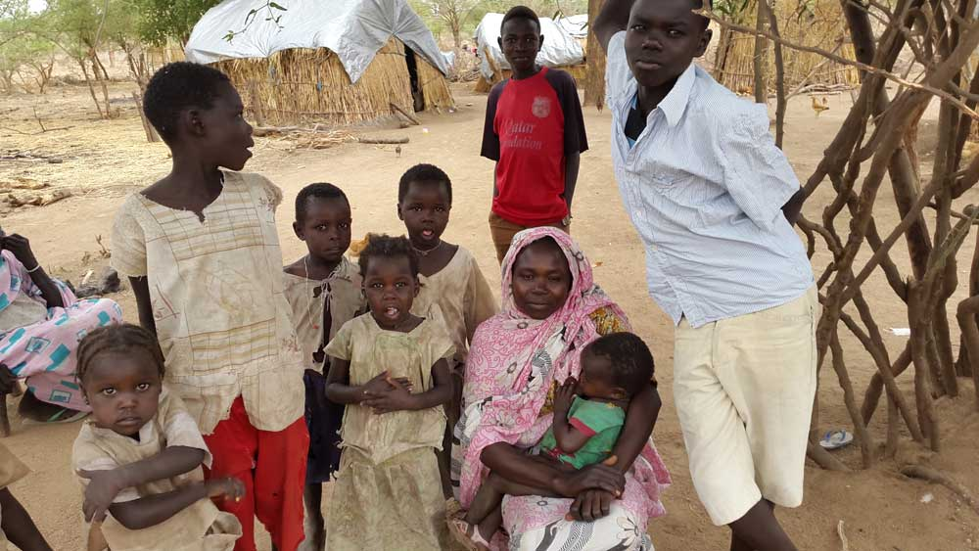
Thank You! charrisonbaird@amnesty.ca
Notes:
PHOTO CAPTION: Bahria Abdalla and her children in South Kordofan State, Sudan, May 2015. The family lost everything when the region they were living in was bombed by Sudan government forces. They fled to Kimli, a site for internally displaced people.
PHOTO CREDIT: Amnesty International
For a large part of its history, Sudan has seen armed conflicts within its borders. Religion has played a major role in these conflicts. Nuba Mountains in Sudan’s South Kordofan state, [are] described by Operation World as “an island of mostly Christian peoples in a sea of Islam”. While the North has been dominated by Muslim Arab tribes, the South has been dominated by the mainly Christian and Animist African people. The Nuba Mountain region was one of the key disputed areas between North and South Sudan, but eventually went to the North, becoming part of the Islamic Republic of Sudan. Since South Sudan’s independence in summer 2011, Sudan’s government – led by Omar al-Bashir, the only sitting President wanted by the International Criminal Court for alleged crimes against humanity – has waged a “relentless” bombing campaign on the South Kordofan region, according to a July report by Amnesty International (AI).
Sources: https://www.worldwatchmonitor.org/2015/08/3995082/ and https://www.amnesty.ca/sites/default/files/sudanreport4august15_0.pdf
EXERCISE:
Does the family pictured here meet the criteria to be recognized as refugees?
No.
Outside their country - No
Due to a well-founded fear - Yes
Of persecution – Yes, war crimes
On one of 5 grounds – Race, Religion, Nationality
Unable to go back - Yes

