Slide 1
4
Amnesty Activism 101: making a difference at home and around the world
Notes:
Welcome participants
Introduce yourself and co-hosts
Thank everyone for joining (adjust for online and in-person)
If in-person, provide directions to washrooms and evacuation route, and any other important site-specific issues
If online, indicate how people can get your attention for questions or concerns (usually use the “raise hand” function or the chat function)
Briefly describe the objective(s), for example (but use your own words):
“By the end of this workshop, you will be able to chat with others about where human rights come from and why they are so important in the world. You’ll be able to describe how Amnesty International researchers document human rights violations, and you’ll be able talk to others about getting involved in promoting and protecting human rights.”
“We will begin with acknowledging Indigenous land and territory, and then briefly reach back into the middle of the last century to set the scene for our current understanding of human rights. From there we will describe the beginnings of Amnesty International and its growth over the past several decades. Lastly, and importantly, we will introduce you to how you can begin taking action and make a dramatic difference in the lives of others.”

Slide 2
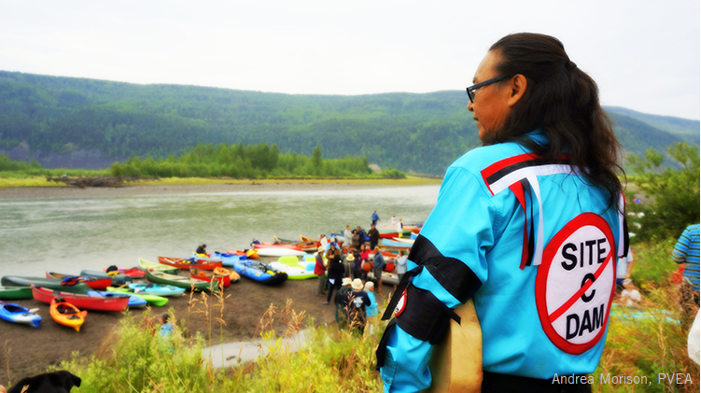
Land and Territory
We acknowledge Indigenous land and territory at the start of public events
Notes:
Please swap in a photo that reflects a local or regional Indigenous community.
Land acknowledgements can take many forms and there is some advice on the Amnesty website but there may be suggestions closer to home. For example, school boards, municipalities, colleges and universities, other social action organizations in your community will often include a land acknowledgement.
Something to consider including, in your own words:
“No matter where you are in settler-named Canada, there are underlying Indigenous rights to land and territory. Acknowledging Indigenous territories at the start of events and other public activities is to deliberately name that this is Indigenous land and affirm Indigenous people have rights to this land. It provides an opportunity for all of us to reflect on our own relationship to the land and the continuous process of colonization that should deeply inform our activism. Acknowledging Indigenous lands and waters is a small act of resistance against the erasure of Indigenous people and their rights.”
https://amnesty.ca/activism-guide/activism-skills-land-and-territory-acknowledgement/
https://amnesty.ca/activism-guide/land-water-and-territorial-acknowledgements/

Slide 3
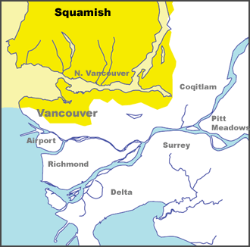
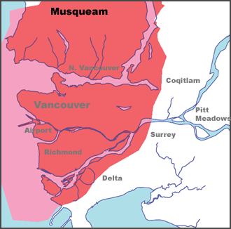
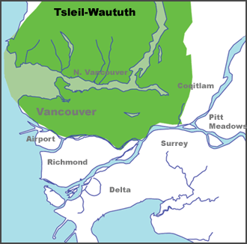
Coast Salish Peoples
https://native-land.ca/
Notes:
Please look up and grab a screenshot of your location, whether the session is online or in-person.
If time allows, invite participants to look up and share whose land they live on (if online, this could go in the chat).

Slide 4
Proposed Agenda
Introduction to human rights and the start of Amnesty International
Overview of current campaign priorities
Opportunities for activism and leadership
Notes:
This is the proposed agenda, please adjust as needed.
This is also a good time to ask people to introduce themselves. Invite people to share their pronouns and if time allows, what their past experience is with Amnesty or other human rights issues and organizations.

Slide 5
Towards a new world order
Terrible atrocities were committed during the Second World War
As early as 1942 numerous governments were meeting in an effort to create a new organization to improve international cooperation
These meetings produced the United Nations, established on June 26, 1945
50 countries signed the UN Charter that day
Notes:
This slide is designed to take participants back to the end of the Second World War, a pivotal moment in the history of human rights and social order.
You can certainly mention that human rights is not a new idea in the 1940s, but in the past, across many societies, enjoyment of human rights and protection from violations could be based on your sex, the colour of your skin, your age, religious beliefs, national origin, and your wealth including land ownership. Over the centuries, social movements pushed for broader definitions and inclusion.
By the way, the UN Charter was brought to life at the San Francisco Opera House.

Slide 6
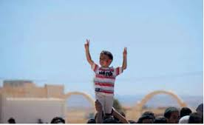
United Nations Charter
To keep peace throughout the world
To develop friendly relations
To work together to improve lives, and eliminate poverty, disease, and illiteracy
To encourage respect for each other’s rights and freedoms
Notes:
The UN Charter describes these four major goals.

Slide 7
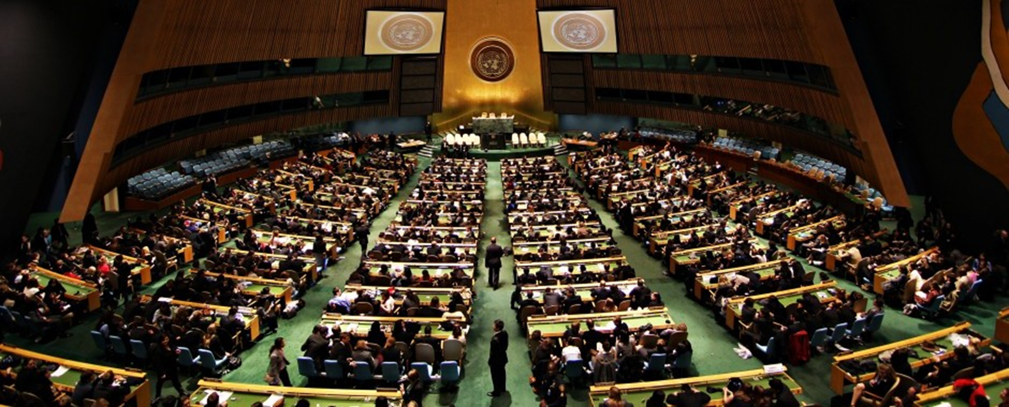
Defining human rights
An early task for the United Nations was to establish a global definition of human rights
Canadian John Humphrey worked with a UN committee to draft an international “bill of rights”
Notes:
John Humphrey was a lawyer and for this task he solicited ideas from around the world and across all sectors of society.
The committee he worked for was chaired by Eleanor Roosevelt, wife of President Theodore Roosevelt.

Slide 8
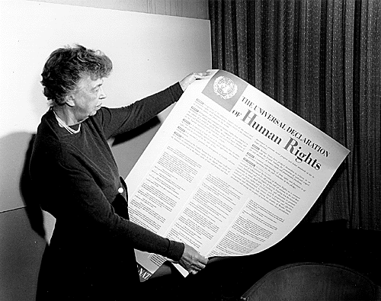
Human rights made universal
The Universal Declaration of Human Rights was approved by the United Nations on December 10, 1948
Notes:
After much discussion and debate, the UNIVERSAL DECLARATION OF HUMAN RIGHTS was approved by the United Nations on December 10, 1948, a day we now celebrate as Human Rights Day and mark with our annual Write for Rights campaign.
The UDHR is a foundational declaration – no subsequent UN declarations, treaties, or conventions can take away from the UDHR, they may only build on it.
A good example is Article 5, which prohibits torture but provides no further guidance. In fact, Amnesty International played a key role in pushing for a convention that would make clear the definition of torture, ill-treatment, and cruel and unusual punishment. Just such a convention was eventually adopted by the United Nations, and Amnesty’s Nobel Peace Prize in 1977 in part recognized our contribution to urging for the creation of this landmark convention.
HANDOUT: if possible, provide participants with a copy of the UDHR. There are many two-page versions for download, and simplified versions if you are working with a younger audience or people for whom English is a second language.

Slide 9
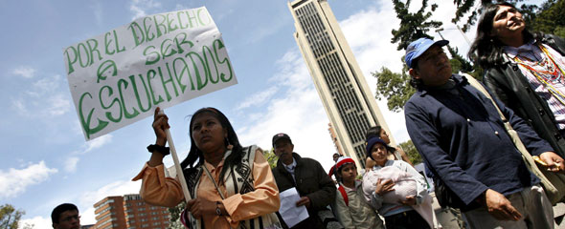
UDHR Article 1
All human beings are born free and equal in dignity and rights.
Notes:
Article 1 makes it very clear that human rights are for all, regardless of the factors that once restricted enjoyment of human rights for many people in every society around the world.
Possible segue to the next section:
“Clearly human rights have always been around, but only over the past 75 years have governments come together to establish international agreements that define human rights, offer protections, and hold perpetrators accountable for abusing human rights.
So, is it working? Are we living up to the idea that all human beings are born free and equal in dignity and human rights?”

Slide 10
Join others in a toast?
Would you raise your cup of tea or coffee and join others in a toast to freedom?
Notes:
Ask this question and invite participants to raise a digital or real hand in a show of support.
Thank everyone who agreed they would join you in a toast, whew!

Slide 11
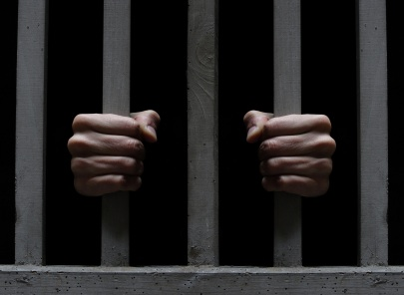
Portugal in 1961
What if you were thrown in jail for what you just did?
Notes:
It feels like an ordinary thing to do, hang out with a group of friends and offer a toast.
Well, back in early 1961, that’s exactly what two students in Portugal were doing when they were promptly arrested, thrown in jail, and sentenced to seven years imprisonment.
The military dictatorship at the time did not want people talking about the freedom they did not enjoy.

Slide 12
But what about the UDHR?
19: everyone has the right to freedom of opinion and expression
20: everyone has the right to freedom of peaceful assembly and association
Notes:
And just to be clear, what we did, and what the students did in 1961, is clearly protected by two articles in the Universal Declaration of Human Rights.

Slide 13
A movement is born
UK lawyer Peter Benenson wrote an article about people imprisoned for expressing their political or religious views
Thousands of people responded to his call for a one year “appeal for amnesty” letter-writing campaign
Notes:
The story caught the attention of British lawyer Peter Benenson, who immediately realized this detention was a violation of rights to freedom of expression and freedom of association, as we’ve just noted.
Benenson further realized that governments worldwide were jailing people who were peacefully expressing views in opposition to governments across the political spectrum. He wanted people to take action.
On May 28, 1961, the London Observer newspaper published an article written by Benenson that described 11 cases where individuals had been jailed for expressing their political or religious views, often without a fair trial. The article was reprinted around the world and thousands of people responded to his call for a one-year “appeal for amnesty” letter-writing campaign that targeted government officials.

Slide 14
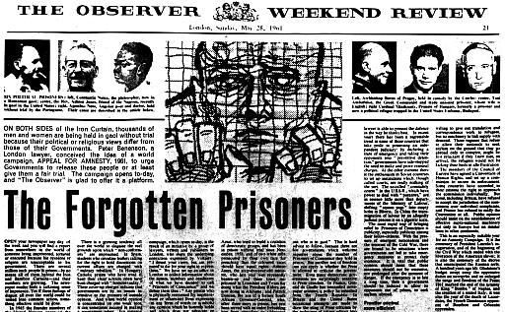
Notes:
Here is the top half of the full-page article as it appeared in the Observer.

Slide 15
“Better to light a candle than curse the darkness”
Notes:
Soon, people were gathering in small groups to write letters together, and it was obvious that it was time to form an organization to coordinate the work.
The name Amnesty International was suggested and adopted. The initial focus was to urge governments to release people who had been arrested for peaceful expression and association.
The candle wrapped in barbed wire was proposed as the logo. The artist took inspiration from a Chinese proverb: it is better to light a candle than to curse the darkness.
It was a call to action on behalf of those unjustly held in the dark corners of prisons around the world.

Slide 16
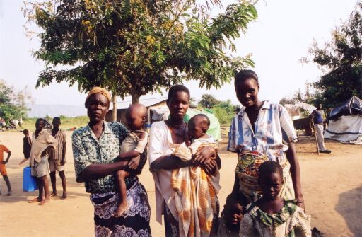
Who Are We?
Amnesty International is a global movement of more than 10 million people who take injustice personally. We are campaigning for a world where human rights are enjoyed by all.
Notes:
From those modest beginnings, Amnesty International has grown into a global movement of more than 10 million people in over 150 countries.
The work has also expanded from the limited focus on freedom of expression and association. We now cover the full range of rights described in the Universal Declaration of Human Rights and the numerous international, regional, and national human rights laws that have been brought into effect over the past 75 years.

Slide 17
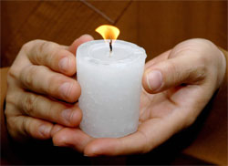
What Do We Do?
We investigate and expose the facts, whenever and wherever abuses happen.
We lobby governments, and other powerful groups such as companies. Making sure they keep their promises and respect international law.
By telling the powerful stories of the people we work with, we mobilize millions of supporters around the world to campaign for change and to stand in defence of activists on the frontline.
Notes:
(In addition to the slide points, you can add some of these notes or use them during Q&A)
So how does Amnesty work?
When we become aware of potential human rights violations, we interview the people affected, as well as witnesses, legal professionals, journalists, representatives of local organizations, and others. Technology and science are playing an increasing role in documenting human rights violations. The actions of government officials are closely scrutinized.
We measure the evidence we find against international human rights laws and standards. We support and work closely with individuals and groups from communities impacted by human rights violations and in collaboration with human rights defenders and civil society organizations we coordinate strategic campaigns. We present our findings and policy recommendations to government officials, journalists, our members and supporters, and the public.
We reinforce the recommendations by mobilizing public pressure to demand an end to human rights violations and to strengthen support for human rights. Amnesty members and supporters send appeals to government officials and corporate leaders – through letters, post cards, petitions, e-mails, artwork, signed banners, and tweets. Our supporters also participate in rallies, marches, street theatre, and protests aimed at raising public awareness and encouraging action.

Slide 18
Our Global Structure
Individuals
International Secretariat
Networks
Groups
Sections
Notes:
The International Secretariat includes the London England headquarters and numerous regional offices. The regional office for the Americas is located in Mexico City.
Sections are mostly country-based, although Canada is an exception with English and Francophone branches.
In Canada, groups are based at schools, colleges and universities, and in the community. Networks are known in Canada as Specialized Teams focused on priority campaigns.
And of course, Amnesty is based on the actions of individuals, as members, supporters, and activists.

Slide 19
Our Values and Commitments
Decolonization
Anti-Racism and Anti-Oppression
Allyship and Alignment
Intersectionality and Nuance
Transparency and Accountability
Boldness and Innovation
Notes:
This list is taken from our 2022-2030 Strategic Plan.
https://amnesty.ca/wp-content/uploads/2022/09/AICES-Strategic-Plan-2022-2030.pdf

Slide 20
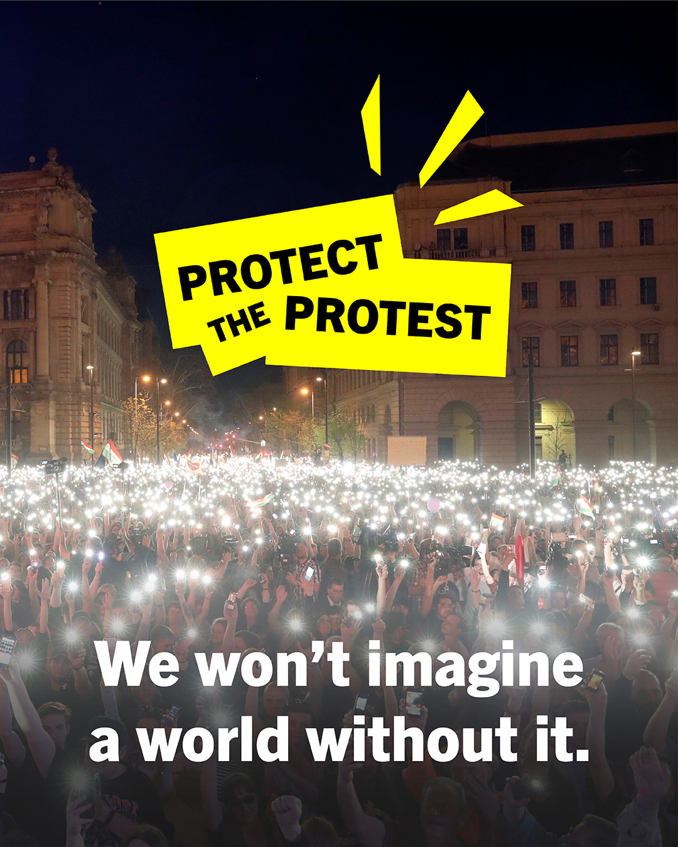
Human Rights Priorities
Global Priorities
Freedom of Expression
Equality and Justice
Amnesty Canada Priorities
Indigenous Peoples and Environmental Justice
Racial Justice
Gender Justice
People on the Move
Crisis Response
Notes:
These priorities are also taken from the Strategic Plan referenced in the previous slide.

Slide 21
Current campaign priorities
Corporate Accountability and Climate Justice
Promote a just energy transition
End criminalizing Indigenous land and water defenders
End evictions near cobalt and copper mines in the DRC
Notes:
These next few campaign slides can be updated from the Amnesty Canada website as needed.

Slide 22
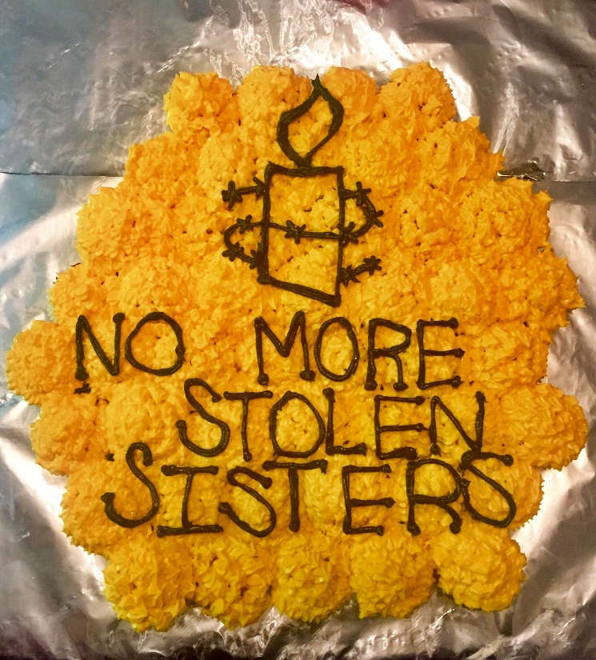
Current campaign priorities
Rights of Indigenous Peoples in Canada
End violence against Indigenous women and girls / end forced sterilization (2024 is the 20th anniversary of our landmark Stolen Sisters report
Call on governments to respect territories and fully implement free, prior and informed consent (pipelines, dams, mines, etc.)

Slide 23
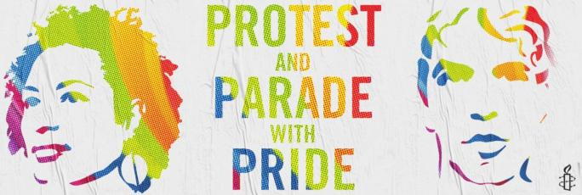
Current campaign priorities
Gender Justice
Call for protection for girls and women promoting and defending human rights
Promote and protect 2SLGBTQQIA+ communities (summer Pride events)
Reproductive rights including abortion

Slide 24
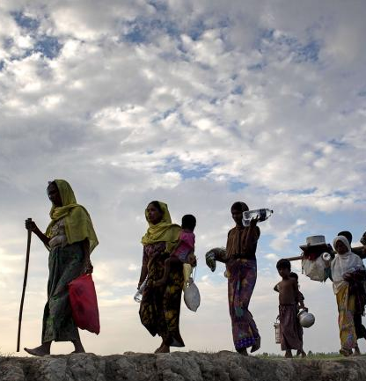
Current Campaign Priorities
People on the Move
Protect refugees and asylum seekers
End immigration detention
Cancel the Third Safe Country Agreement

Slide 25
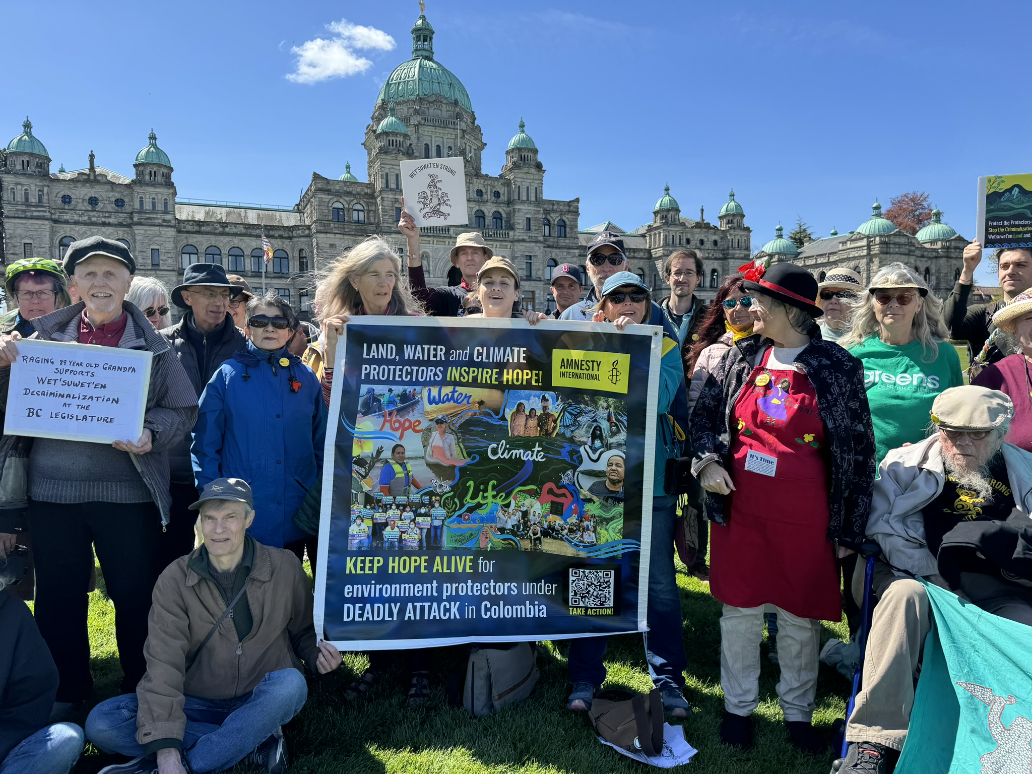
Current Campaign Priorities
Human Rights Defenders in the Americas
Protect the protest in Peru and Colombia
Protections and justice for environmental and human rights defenders

Slide 26
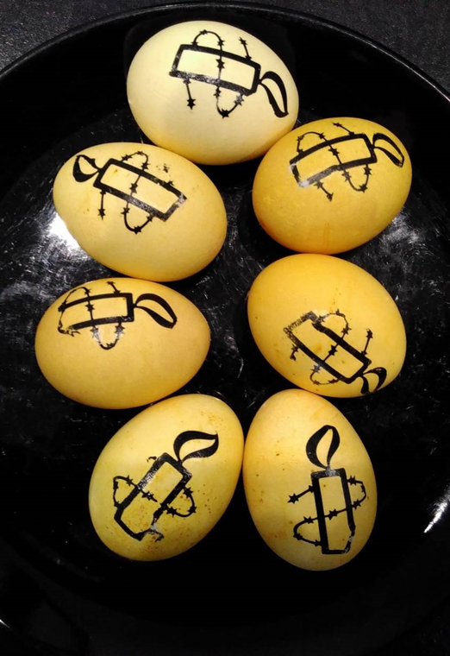
Current Campaign Priorities
Crisis Response
Online actions and local days of action focused on human rights challenges in Afghanistan, China, Iran, Israel and Occupied Palestinian Territory, Sudan, and Ukraine.

Slide 27
Let’s get you started!
Letter writing
Subscribe to email newsletters
Join the Urgent Action Network
(Every fall) Host a Write for Rights event
Notes:
For links to newsletters and the Urgent Action Network invite participants to go to amnesty.ca
“One of our longest standing programs is the Urgent Action Network. Members across Canada (and around the world), stand by ready to write a letter, send an e-mail, or click on an SMS alert.
Urgent actions are issued in response to an urgent call to stop human rights violations from happening, like preventing torture or an imminent execution, or to demand government or prison officials take immediate action to protect human rights.”
Write for Rights is an annual campaign that highlights around ten cases for global attention on and around December 10, Human Rights Day. Our members and supporters around the world organize or join events, or write on their own, generating millions of letters and messages in support of justice.

Slide 28
Join with others!
Volunteer opportunities:
Join or start a group at your school
Join or start a group in your community
Join a team: refugees and migrants, climate justice, gender rights
Apply to become a national (youth) organizer
Apply to train as a Grassroots Activist Leader
Register online
Notes:
(This list of volunteer opportunities changes from time to time. Please check that the link is working or if the registration process has changed.)
“Another way many of our activists and supporters get involved is by joining or forming an Amnesty group at their school or in their community. These groups write letters, table at school or community events, plan and hold public events, visit their Member of Parliament, and take to the streets. With more than 160 youth and student groups across the country, our Youth and Student program is one of the largest youth activist programs in Canada.”
(If you are aware that one or more participants are already involved with Amnesty, you might want to invite them to describe their role(s).)

Slide 29
Online Learning Centre
Notes:
The Online Learning Centre features an online version of this workshop and five brief skills-training videos.
https://amnesty.ca/what-you-can-do/human-rights-education/

Slide 30
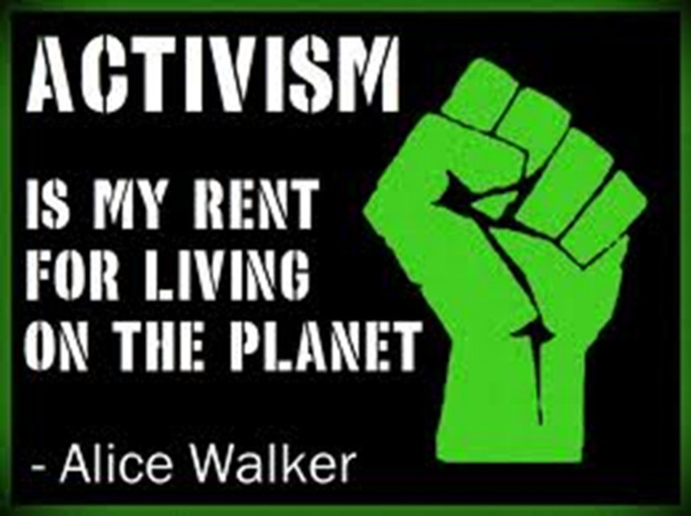
You can make a difference!
Read the Activism Guide
Like us on Facebook
Follow us on X and Instagram and share!
Visit our events calendar for upcoming webinars and days of action
Notes:
“Want to get started? Amnesty Canada offers two key resources to make sure you are aware and ready to participate in current campaigns and days of action.
The Activism Guide is published seasonally, and it is full of ideas for taking action. Actions could include tabling at community events, meeting your Member of Parliament, organizing panel discussions, film screenings, and street protests.
Amnesty Canada also maintains an online calendar of events that lists campaign activities and days of action that are coming up.”

Slide 31
Our Impact
Notes:
(This slide should feature a good news story – check amnesty.ca for a recent story or one that may resonate with participants.)
“One of the things that keeps Amnesty members and supporters motivated is the ever-growing list of success stories we can point to, ranging from individuals being released from detention to the creation of new international human rights laws and standards.”

Slide 32
Notes:
(Feel free to replace this quote with one you like!)
“From letter-writing to organizing public events, there are so many ways you can be involved in promoting and defending human rights. I hope this workshop has given you a sense of what is possible, and you’re thinking about how you want to get started.
As we come to the end of this workshop, I want to share with you one of my favourite inspirational quotes from Nelson Mandela: What counts in life is not the mere fact that we have lived, it is what difference we have made to the lives of others. Words to live by!”

Slide 33
Thank you!
For more information on any aspect of getting involved with Amnesty International please contact:
Activism Team activism@amnesty.ca
Notes:
(Edit with your name and email or the club/group name and contact details!)

